Slide 1
DISTRIBUTED SYSTEM
UNIT 1
CHAPTER 1

Slide 2
What is a Distributed System?
A distributed system is a collection of autonomous computers linked by a computer network that appear to the users of the system as a single computer.
System architecture: the machines are autonomous; this means they are computers which, in principle, could work independently;
The user’s perception: the distributed system is perceived as a single system solving a certain problem (even though, in reality, we have several computers placed in different locations). By running a distributed system software the computers are enabled to:
- coordinate their activities
- share resources: hardware, software, data.

Slide 3
Distributed System:
CPU
CPU
Memory
Disk
Memory
Disk
Communication Network
CPU
CPU
Memory
Disk
Memory
Disk

Slide 4
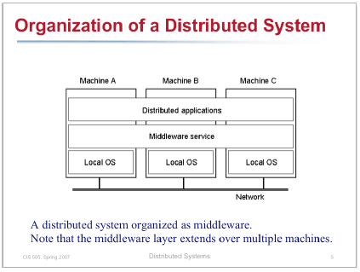

Slide 5
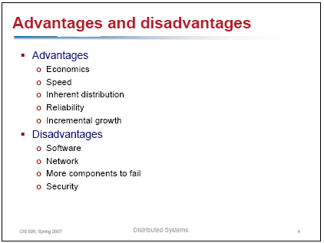

Slide 6
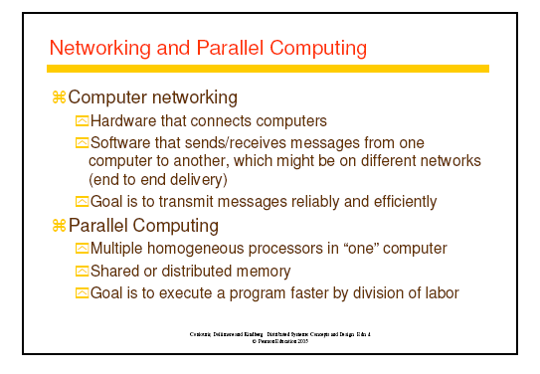

Slide 7
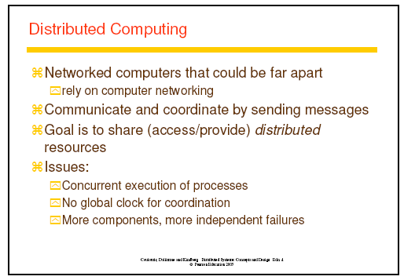

Slide 8
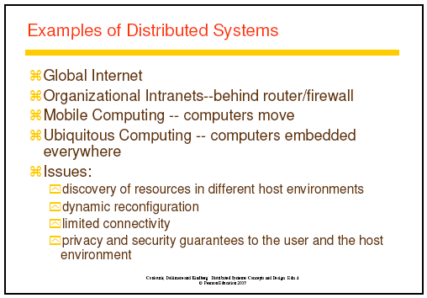

Slide 9
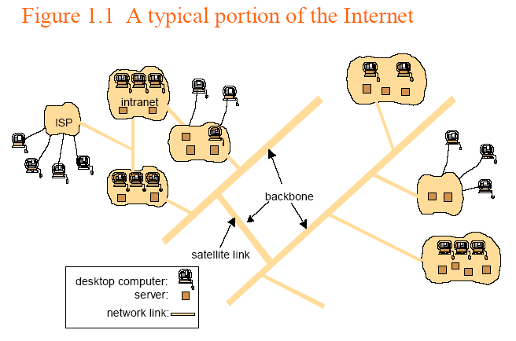
INTERNET

Slide 10
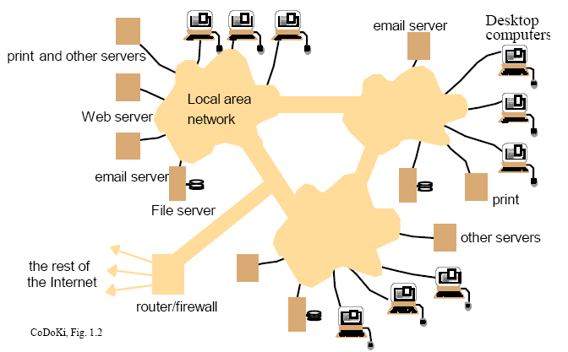
INTRANET

Slide 11
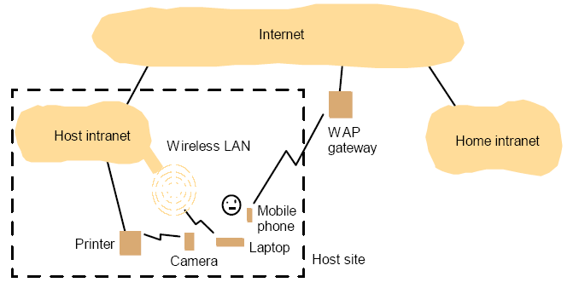
Portable and Handheld Devices

Slide 12
Why Distribution?
The impetus behind development of DS was availability of microprocessors at low cost and advances in communication Technology.
Resource sharing
Enhanced performance
- Rapid response time & higher throughput.
Improved Reliability and Availability
- A failure of some components does not affect others.
- Replication made system fault tolerant.
Modular expandability
- Hardware, software resources extends.
Scalability

Slide 13
Resource Sharing and the Web
For effective sharing of resources, resources must me managed by a program that offers a communication interface, enabling the resource to be accessed and updated reliably and consistently.
• Hardware resources (reduce costs)
- Printers, hard disk etc.
• Software resources (shared usage information)
- Files, search engines, database, data object
World Wide Web: CERN (European centre for nuclear research),1989, Switzerland. Evolving system for publishing and accessing resources and services across the internet through web browser.
- HTML
- URL
- HTTP
Client
(Process)
Request
Server
(Process)
Reply

Slide 14
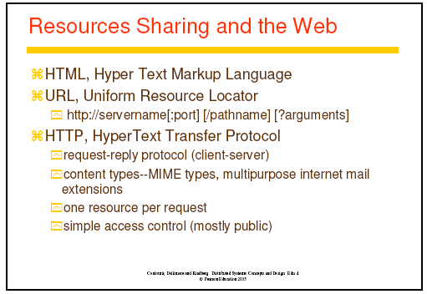

Slide 15
HTML
Hyper Text Markup Language, for specifying the contents and layout of pages as they are displayed by web browsers.
Specify Links (Hyperlinks)
Example:
<IMG SRC=“http://www.cdk4.net/images/abc.jpg”>
<P>
Welcome to earth
<A HREF=“http://www.cdk4.net/moon.html”>moon</A>
</P>
Only the browser interprets the HTML text. But server inform the type of content.

Slide 16
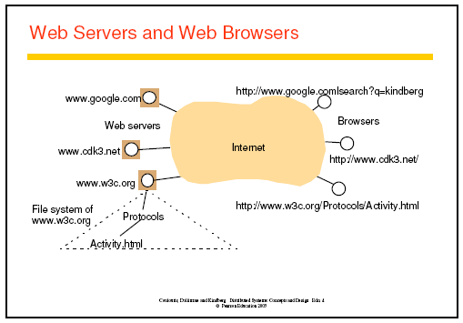
URL

Slide 17
HTTP
Hyper text transfer (request-reply) protocol defines the ways in which browsers and other type of client interact with web server.
Request Reply Interactions:
-If requested file exist then reply otherwise shows “404 not found”
error.
Content Type: MIME types
- Browser not necessarily capable of handling every type of
contents. It may be able to display GIF format but not JPEG.
One resource per request
Dynamic Pages:
- Browser send HTTP request to a web server containing the
values specified by user. A program that web server run to
generate content for their clients referred to as CGI program.
Downloaded code:
- Service related code run inside the browsers at user’s
computer.
APPLET, JAVA SCRIPT. Chat Applications is an example.

Slide 18
Challenges: Heterogeneity
Heterogeneity of
– networks
– computer hardware
– operating systems
– programming languages
– implementations of different developers
Portability, interoperability:
Mobile code, adaptability (applets, agents):
- Mobile code can be sent from one computer to other and run at
destination. Virtual machine provides a way making code
executable on any H/W.
Middleware (CORBA etc):
- Applies to a software layer that provides programming abstraction
as well as masking the heterogeneity of underlying N/W, H/W, OS,
and programming language.

Slide 19
Challenges: Openness
Openness determine whether the system can be extended and re-implemented in various ways.
Needs
- extensions: new components
- re-implementations (by independent providers)
Implementation
- public interface
- standardized communication protocols
- open DS constructed from heterogeneous H/W, S/W,
possibly from different vendors.

Slide 20
Challenges: Security
Three components
- Confidentiality (protection against unauthorized access)
- Integrity (protection against alteration)
- Availability (protection against to access the resources)
Two Security Challenges yet not fully meet
- Denial of Service attacks: A user may wish to interrupt service for
some reason
- Security of mobile code: someone receives an executable
program as an electronic mail attachment. The possible effects of running the program are unpredictable.

Slide 21
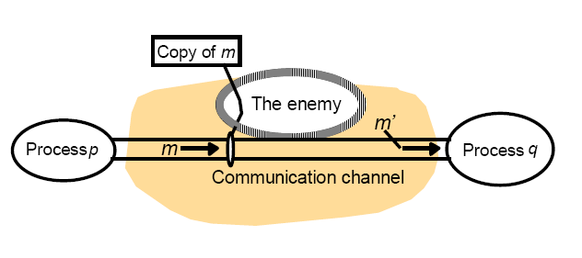
The enemy

Slide 22
Defeating Security Threats
Techniques
– cryptography
– authentication
– access control techniques
• intranet: firewalls
• services, objects: access control lists, capabilities
Policies
– access control models
– lattice models
– information flow models
=> secure channels, secure processes, controlled access,
controlled flows

Slide 23
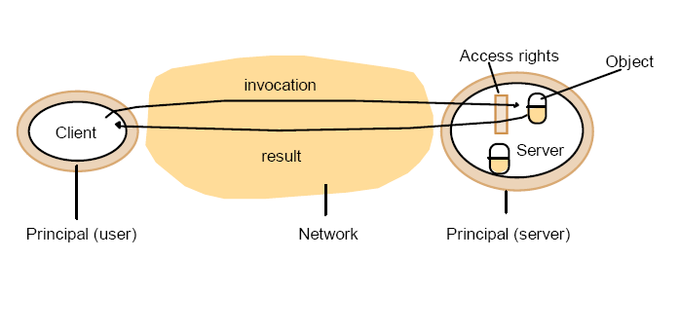
OBJECTS AND PRINCIPALS

Slide 24
Challenges: Scalability
The system will remain effective when there is a significant increase
in
– the number of resources
– the number of users
The architecture and the implementation must allow it
The algorithms must be efficient under the circumstances to be expected
Controlling the cost of physical resources
Controlling the performance loss
Preventing software resource running out.
Avoiding performance bottlenecks
Example: the Internet

Slide 25
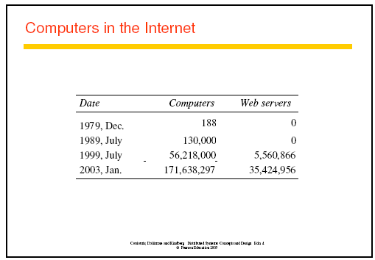

Slide 26
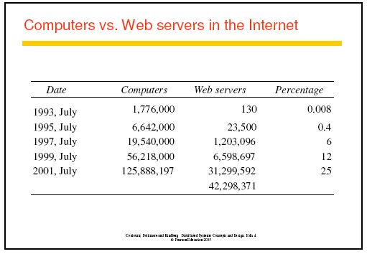

Slide 27
Challenges: Failure Handling
More components => increased fault rate
Increased possibilities
– more redundancy => more possibilities for fault
tolerance
– no centralized control => no fatal failure
Issues
– Detecting failures: Challenge is to manage in the presence of
failure that can not be detected.
– Masking failures
– Recovery from failures
– Tolerating failures
– Redundancy

Slide 28
Challenges: Concurrency
Concurrency:
Services and applications allow multiple client request to be
processed concurrently.
– Several simultaneous users => integrity of data
• mutual exclusion
• synchronization
• ext: transaction processing in data bases
– Replicated data: consistency of information?
– Partitioned data: how to determine the state of the
system?
– Order of messages?
There is no global clock!

Slide 29
Challenges: Transparency
The fundamental idea: a collection of independent, autonomous computers.
• Transparency
– concealment of distribution => user’s viewpoint: a single unified system
Access Transparency
Location Transparency
Replication Transparency
Failure Transparency
Mobility Transparency
Performance Transparency
Scaling Transparency

Slide 30
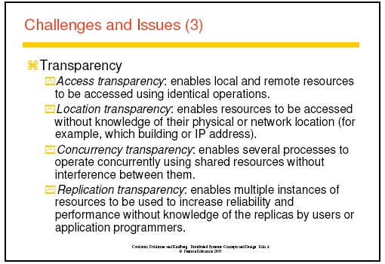

Slide 31
